Slide 1


Burst-MAC: A MAC Protocol for Handling Burst Traffic in LoRa Network
Aakriti Jain¹, Md Ashikul Haque¹, Abusayeed Saifullah¹, Haibo Zhang²
¹ Wayne State University, USA
² University of Otago, New Zealand
IEEE RTSS 2024, York, United Kingdom

Slide 2
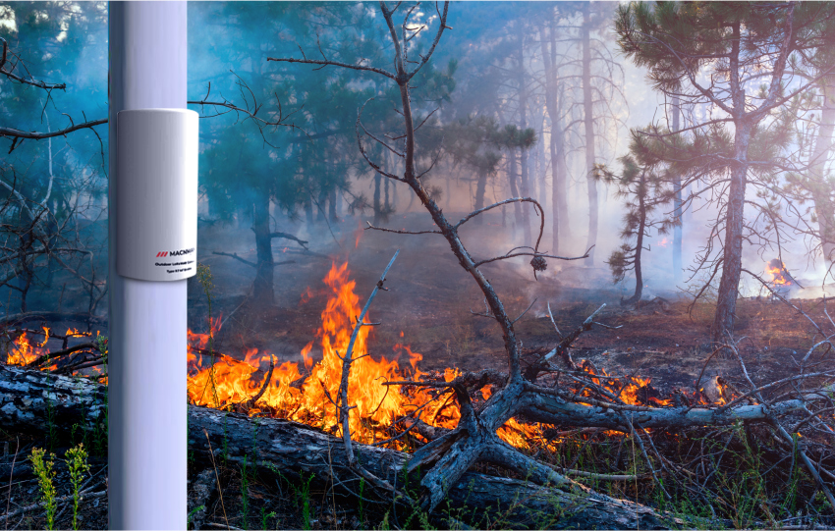




Low Power Wide Area Network
Low Power Wide Area Network (LPWAN) has enabled various IoT applications.
Environment Monitoring
Agriculture Monitoring
(Long Range)
Wide coverage
High capacity
Long battery life
Low Cost
Smart City
Smart Metering
5.9 million gateways and 300 million end nodes with LoRa deployed worldwide,
over 600 documented use cases (May 2024).
Credits to LoRa Alliance
https://www.semtech.com/lora
Notes:
The growing demand for Internet-of-Things (IoT) applications has led to the development of several Low-Power Wide-Area Network (LPWAN) technologies in recent years.
Lora Operates in unlicensed sub-GHz band, and facilitates
long-range connectivity ,
low power consumption,
and low data-rate transmissions
It's widely available worldwide, with over 600 documented use cases such as

Slide 3
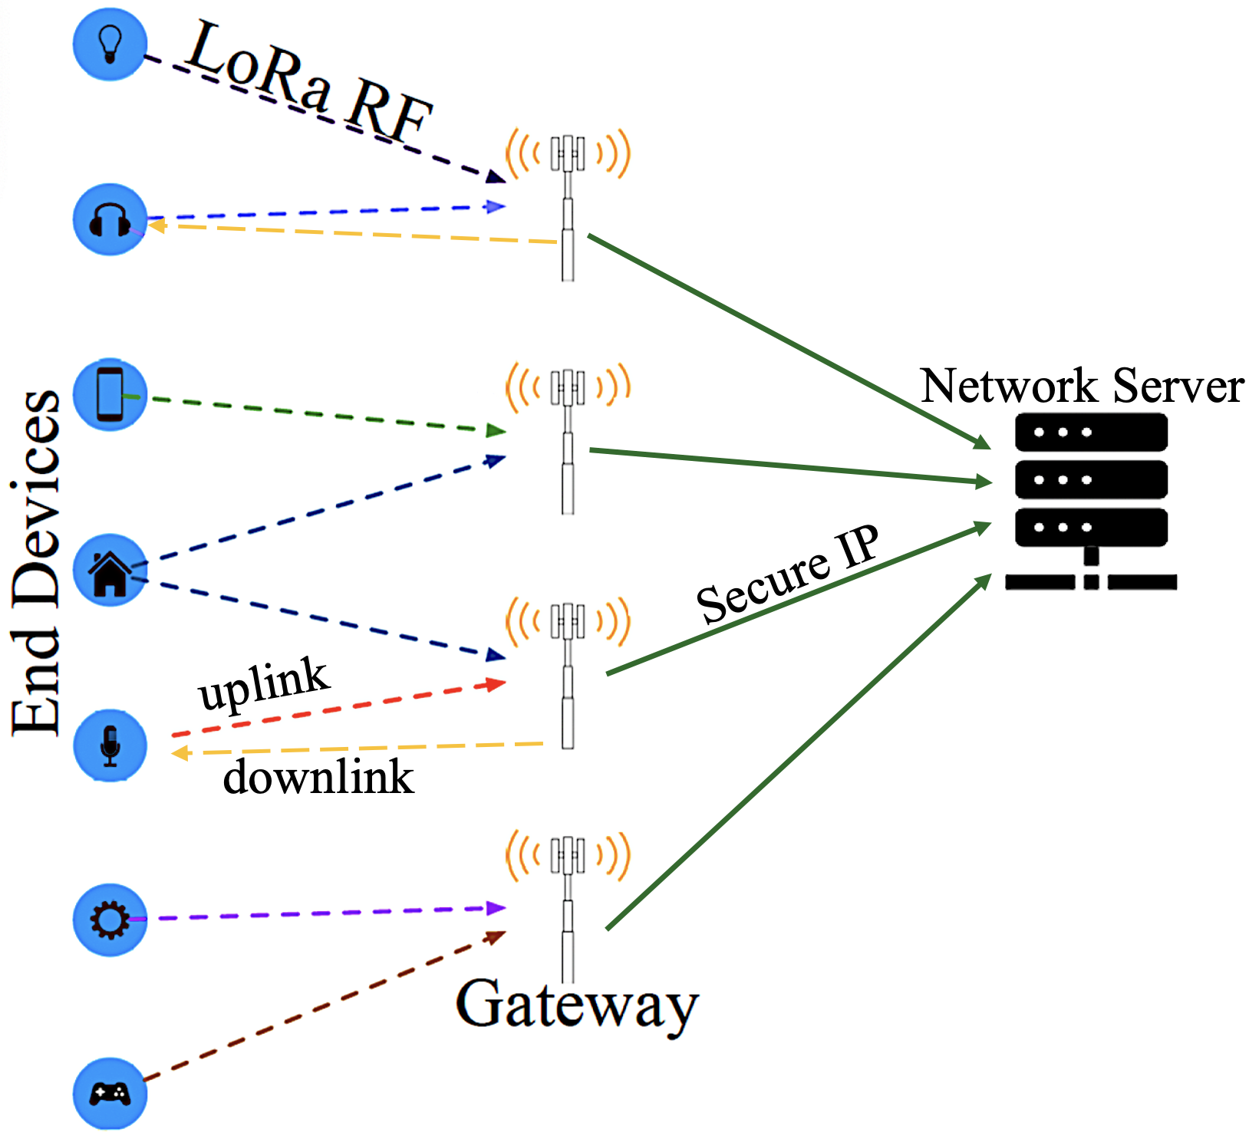
LoRa Overview
End Devices (nodes), Gateway, Network Server.
Communication Path/ Channel:
Nodes transmit packets to gateway via Uplink channel.
Gateway communicates with nodes via Downlink channel.
Chirp Spread Spectrum (CSS) technology.
Spreading Factor (SF): implies the no. of raw bits encoded in a symbol. (SF 7-12)
Fig: LoRa network architecture
Notes:
A typical LoRa architecture includes many end-devices or (LoRa nodes), one or more gateways and a network server. Nodes are sensors/actuators that directly communicate with the gateway wirelessly over long-range.
LoRa is the PHY layer of LoRa stack while LoRaWAN is the MAC layer.
LoRaWAN divides the available
spectrum into multiple uplink and downlink channels. Nodes
send data to the gateway on the uplink channels and the
gateway responds on the downlink channels.
LoRa uses CSS modulation technique and offers several runtime-adjustable transmission parameters, out of which spreading factor is a major one.

Slide 4
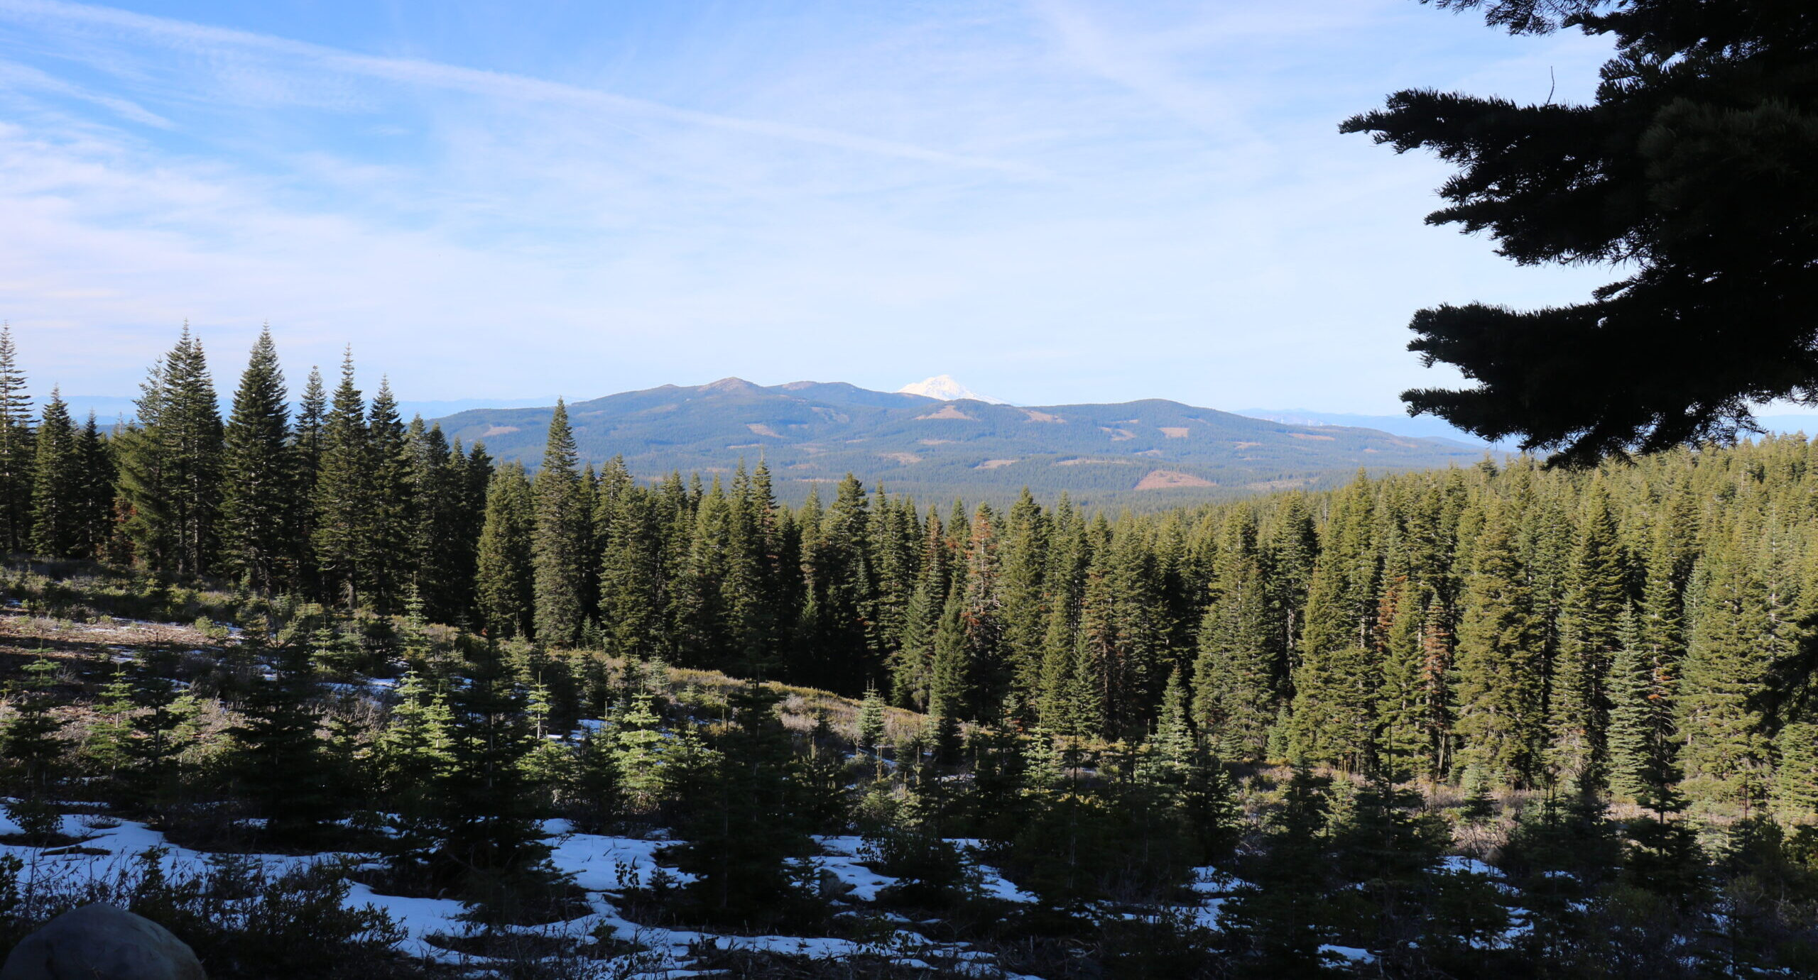



LoRa Overview
LoRa is typically designed to handle very infrequent communications.
Fig: Forest fire monitoring in California forest
Credits:
state foresters California

Slide 5
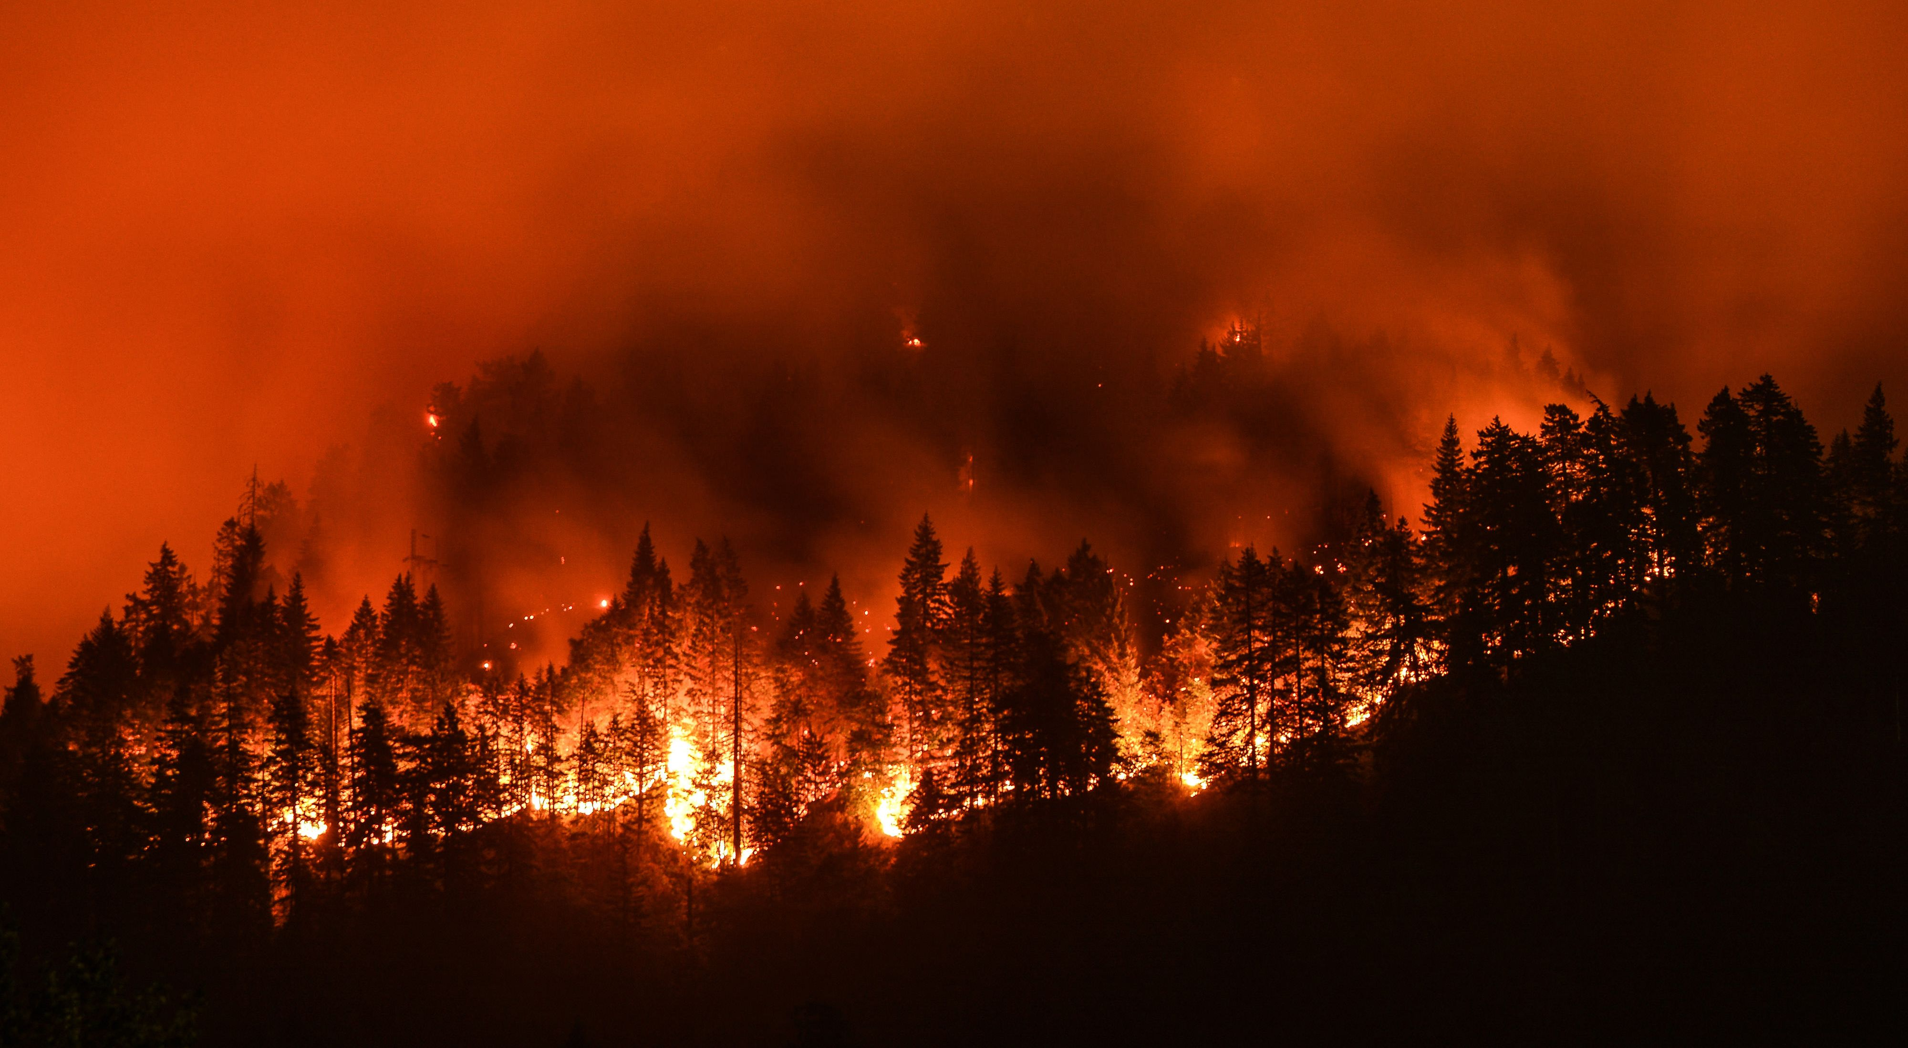
What is Burst Traffic?
However, many applications experience Burst Traffic. E.g., emergencies like Forrest Fire, Volcanic Eruption, Earthquake, or Smart Cities during peak hours.
Numerous nodes start transmitting data packets simultaneously in quick succession.
Fig: California Wildfire (2021)
Leads to temporary surge in network activity ⚠️
Credits: The Nature Conservancy
Notes:
However, upon detecting a fire
sensors near the affected area begin generating burst traffic,
likely indicating intense heat or smoke.
All nodes start transmitting data packets to the gateway simultaneously in a quick succession leading to temp surge in network traffic.
This sudden uptick in data transmission plays a pivotal role in
alerting authorities and facilitating timely responses such as
evacuation in the event of a fire or eruption.

Slide 6
Consequences of Burst Traffic in LoRa
914.2
915
915.8
Frequency (MHz)

Slide 7

Consequences of Burst Traffic in LoRa
Collisions
914.2
915
915.8
Frequency (MHz)

Slide 8
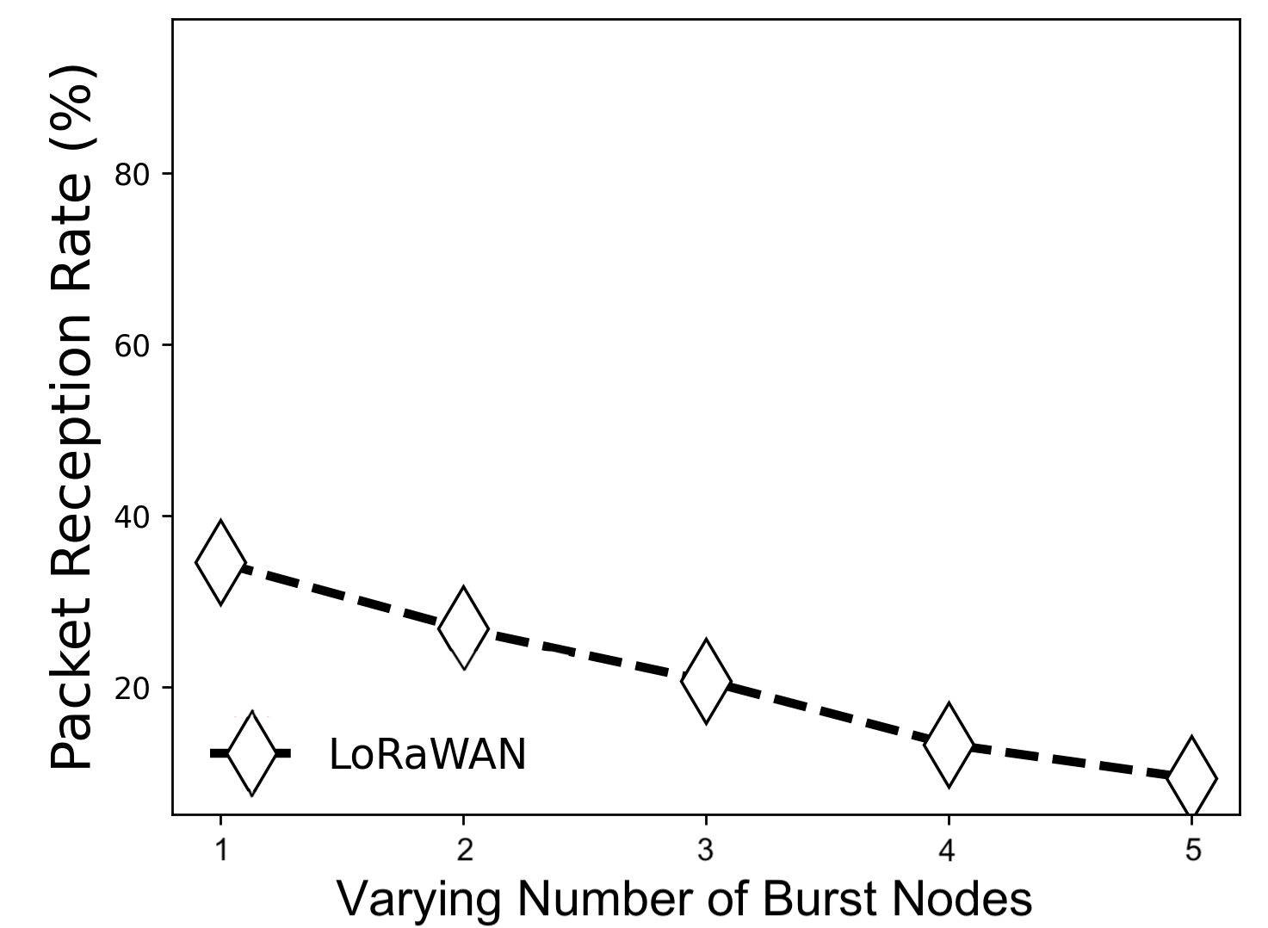
Why is it necessary to handle Burst Traffic?
Current MAC protocol of LoRa: LoRaWAN adopts ALOHA NO collision avoidance mechanism!
Increased packet loss*
Increased retransmissions
Rapid battery depletion
Excessive network latencies
Degraded throughput*
Collisions
Single channel
914.2
915
915.8
Frequency (MHz)
Fig: Packet Reception Rate for 5 nodes
*Validation from experiment in our lab
Notes:
LoRaWAN-
34.54
26.81
20.77
13.35
9.39

Slide 9
Why is it necessary to handle Burst Traffic?
Current MAC protocol of LoRa: LoRaWAN adopts ALOHA NO collision avoidance mechanism!
Increased packet loss*
Increased retransmissions
Rapid battery depletion
Excessive network latencies
Degraded throughput*
Ensuring successful transmission of this traffic without loss is critical
Collisions
914.2
915
915.8
Frequency (MHz)
Fig: Packet Reception Rate for 5 nodes
*Validation from experiment in our lab
Notes:
Ensuring successful transmission of this traffic without loss is critical to alert authorities and enable timely responses.

Slide 10
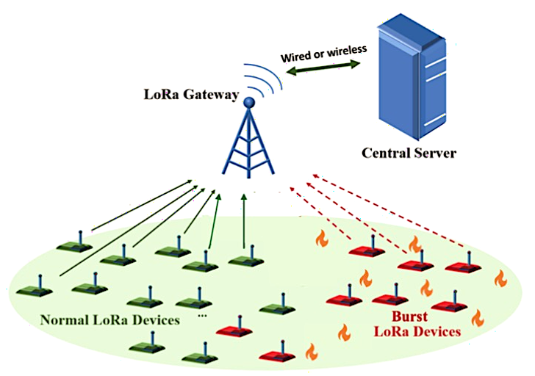
Burst-MAC
We introduce Burst-MAC, a low-overhead and bounded latency MAC protocol for LoRa networks to handle burst traffic.
Semi-Distributed Scheduling Mechanism.
Nodes compute their Tx slots individually.
Eliminates the need of centralized slot distribution.
Devices switch to Burst-MAC only when burst is detected.
Work in LoRaWAN mode otherwise.
No time synchronization required during non-burst periods!
Fig: Nodes in the effected area undergo burst and switch to Burst-MAC. Nodes in non-effected areas work in LoRaWAN mode.

Slide 11
Burst-MAC
Exploits parallel packet reception capability of LoRa gateway by using Orthogonal Virtual Channels (VC).
500 kHz
250
125
Bandwidth
(BW)
frequency
frequency
SF7
Spreading Factor (SF)
SF8
SF9
…
time
<Physical Channel (Central Frequency, Bandwidth), Spreading Factor> $→$ Virtual channel
e.g., <Ch 1, SF 7> -> VC 1
<Ch 1, SF 8> -> VC 2
<Ch 4, SF 9> -> VC 3

Slide 12

Burst-MAC Design
Determining the Start of Burst Traffic
+ Collisions exceeded threshold?
Burst Detected!
Explicit Feedback- Nodes under burst
Switch to Burst-MAC
uplink
Piggybacked ACK
packet generation exceeded threshold?
Burst!
Notes:
Gateway-
Identifies burst when VC collisions exceed a predefined threshold.
to burst nodes.
Beacons provide a timing reference for clock synchronization with gateway.
Thereafter, they use Burst-MAC for subsequent transmissions. Note that, it is not required for the gateway and the burst nodes to switch to Burst-MAC at the same time. A burst node can switch to Burst-MAC once it detects burst or receives the notification from the gateway

Slide 13

Burst-MAC Design
Grouping Nodes based on Virtual Channels
LoRa in the US, m_{up} uplink channels and s total number of SF
Gateway groups the nodes based on their VC.
Only a few nodes per group.
Each VC is a unique group.
Collisions confined within groups.
Enables concurrent transmissions.
Now collisions need to resolved only inside each VC, which can be done using a transmission scheduling policy.
903
904
Frequency (MHz)
902
927
928
s= 6, m_{up} = 64
Virtual Channels: 6 $×$ 64 = 384
Hundreds of Virtual Uplink Channels.

Slide 14
Burst-MAC Design
Hash-based Scheduling for Uplink Transmissions
Hash-based semi-distributed transmission scheduling policy!
Nodes in burst mode within a VC individually compute their time slots for uplink transmission using a hash function, e.g.,
n₀
n₁
n₂
n₃
n₄
n₅
n₆
n₇
n₈
n₉
ID 1230 1231 1232 1243 1244 1235 1245 1266 1287 1299
h(K) = k mod M
Hash value
Node ID
No. of nodes in a group
Hash value = node’s uplink Tx time slot,
Superframe defines the total no. of time slots for a group
Notes:
Naturally synchronized

Slide 15
Burst-MAC Design
Hash-based Scheduling for Uplink Transmissions
n₀
n₁
n₂
n₃
n₄
n₅
n₆
n₇
n₈
n₉
ID 1230 1231 1232 1243 1244 1235 1245 1266 1287 1299
h(K) = k mod M
Time Slot = Node ID % 10
1
Time
slots
0
5
6
9
2
7
3
4
5
Superframe length = 10

Slide 16
Burst-MAC Design
Ensuring Collision Free Transmissions
n₀
n₁
n₂
n₃
n₄
n₅
n₆
n₇
n₈
n₉
ID 1230 1231 1232 1243 1244 1235 1245 1266 1287 1299
Time
slots
0 1 2 3 4 5 5 6 7 9
Collision!!
Burst-MAC dynamically handles time slot collisions.
New time slot via Piggybacked ACK

Slide 17
Burst-MAC Design
Ensuring Collision Free Transmissions
n₀
n₁
n₂
n₃
n₄
n₅
n₆
n₇
n₈
n₉
ID 1230 1231 1232 1243 1244 1235 1245 1266 1287 1299
Time
slots
0 1 2 3 4 5 8 6 7 9
Collision Resolved!!
Burst-MAC maximizes overall utilization.
Ensures Bounded Latencies for every packet.
Before collision resolution: 2 * N_{i} time slots
After collision resolution: N_{i} time slots
Where, N_{i} = superframe length
Notes:
Bounded Latencies for successful uplink packets only. We do not consider lost packets

Slide 18
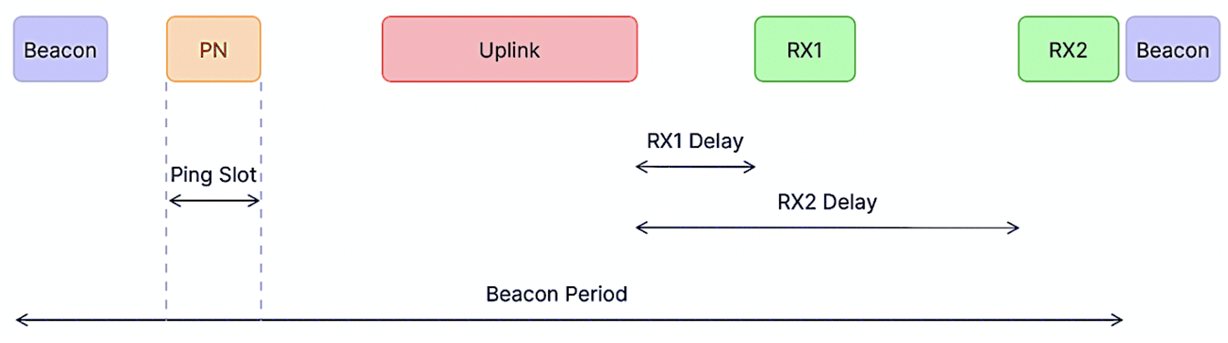
Burst-MAC Design
Downlink Communication in Burst-MAC
To ensure new schedules are received successfully, burst nodes work in Class-B mode.
Nodes can receive ACKs in either RX1, RX2, or additional ping slots. More chances to receive downlink ACK containing new Tx slots.
Fig: Class-B mode of LoRa
Increases chances of successful collision resolution

Slide 19
Burst-MAC Design
Final Collision Free Transmission Slots look like
n₀
n₁
n₂
n₃
n₄
n₅
n₆
n₇
n₈
n₉
ID 1230 1231 1232 1243 1244 1235 1245 1266 1287 1299
Time
slots
0 1 2 3 4 5 8 6 7 9
One Superframe (within one VC)
n₀ n₁ n₂ n₃ n₄ n₅ n₇ n₈ n₆ n₉
n₀ n₁ n₂ n₃ n₄ n₅ n₇ n₈ n₆ n₉
t₀ | t₁ | t₂ | t₃ | t₄ | t₅ | t₆ | t₇ | t₈ | t₉ | t₀ | t₁ | t₂ | t₃ | t₄ | t₅ | t₆ | t₇ | t₈ | t₉
Pkt1
Pkt 2/ ReTx
Round 1 Tx
Round 2 Tx

Slide 20
Burst-MAC Design
Handling the end of Burst Traffic
+ Increased no. of unused slots?
Burst End!
End Burst-MAC. Stop sending any schedules.
Explicit Feedback- Nodes ended
uplink
Transition from Class-B to Class-A. Stop computing tx slots.
packet generation within threshold?
Burst End!

Slide 21


Thank you!
Aakriti Jain
aakriti.jain@utdallas.edu
Read my paper at:
DOI: 10.1109/RTSS62706.2024.00022

